Slide 1
Learning Based Compact Thermal Modeling for Energy-Efficient Smart Building Management
Hengyang Zhao, Daniel Quach,
Shujuan Wang, Hai Wang,
Hai-Bao Chen, Xin Li,
Sheldon, X.-D. Tan
Department of Electrical Engineering
University of California, Riverside, CA

Slide 2
Outline
Motivation
Review of EnergyPlus program
Review of RNN architectures
RNN-based thermal modeling methods
Two RNN implementations
Cross validation for accuracy improvement
Experimental results
Summary

Slide 3
Building energy consumption is significant in US
Building section accounts for about 41% energy consumption in United States om 2011.
he U.S. buildings sector alone accounted for 7% of global primary energy consumption in 2010.
About 50% of the energy consumed in buildings are directly related to space heating, cooling and ventilation (HVAC) [1]

Slide 4
Smart building with wireless sensors and HVAC control
In office/residual buildings, climate control is most often provided through a central heating, ventilating, and air conditioning (HVAC) system
Wireless sensors and data analysis and control are required for new smart building.
More complicated and smart HVAC control is required to meet the energy efficiency and client demand. Hence, compact yet accurate building thermal modeling is required.

Slide 5
EnergyPlus Software [www.energyplus.gov]
A fully integrated numerical energy simulation tool for building, HVAC, water, and renewables
Enable integrated energy performance analysis of low-energy technologies in commercial and residential buildings
Sub-hourly calculations
Many output metrics: energy, water, emissions
Weather data for more than 2100 locations worldwide
Calculations are based on first-principle based numerical methods
High computational costs
Not suitable for control-based analysis

Slide 6
A typical HVAC System

Slide 7
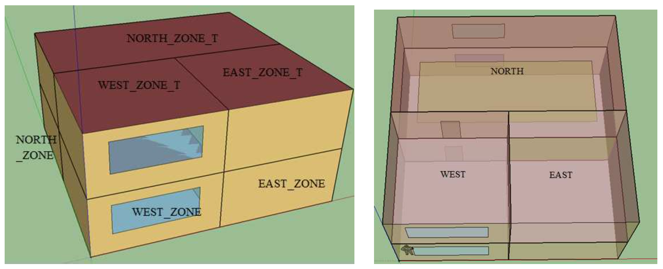
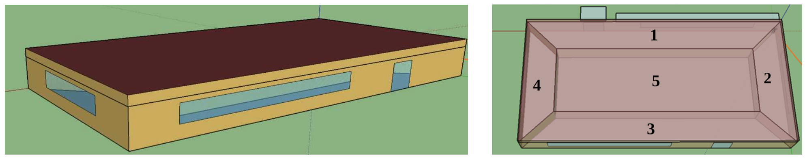
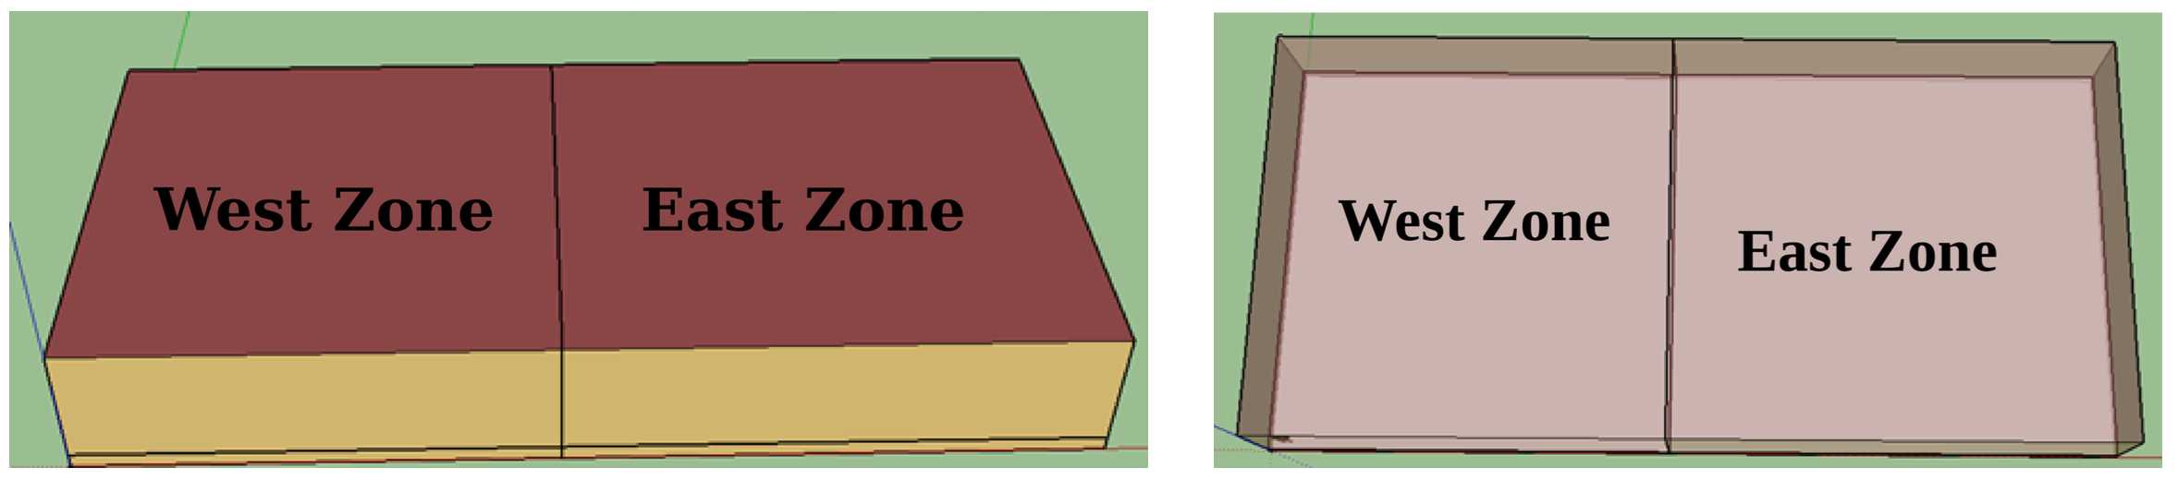
Some building cases from EnergyPlus
2-zone data center
5-zone office building
6-zone office building

Slide 8
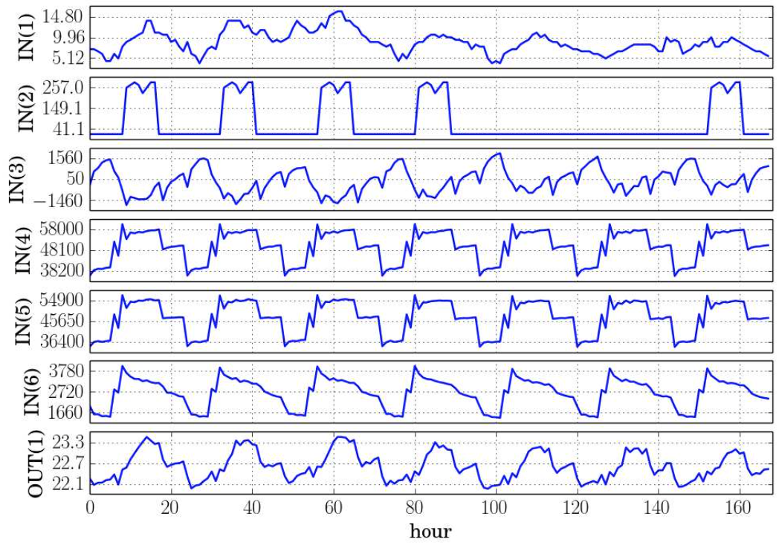
EnergyPlus Simulation
INPUTS: Ambient temperature, people factors, equipment factors, HVAC inputs, etc.
OUTPUTS: Temperatures of the interested spaces/rooms
Ambient Temperature
Light Heating Rate
Electrical Equipment Heating Rate
Ambient Temperature
Air System Cooling Rate (Zones)
Air System Cooling Rate (Plenum)
Notes:
Plenum space, enclosed spaces (in buildings) used for airflow

Slide 9
Non-linear control
Advanced control method is needed in order to minimize HVAC energy cost and meet the temperature goal
EKF: Extended Kalman Filter [2]
Computational cost is sensitive to number of state variables
We need a compact thermal model to describe the smart building system, with acceptable modeling error

Slide 10
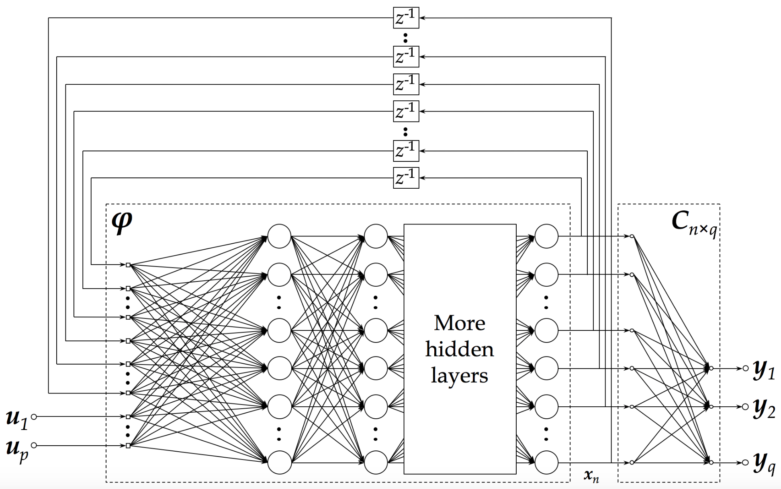
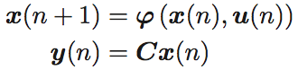
NLSS architecture
NLSS: Non-linear State Space neural network [3]
Closer to non-linear state space representation
Slightly higher variance in experiment

Slide 11
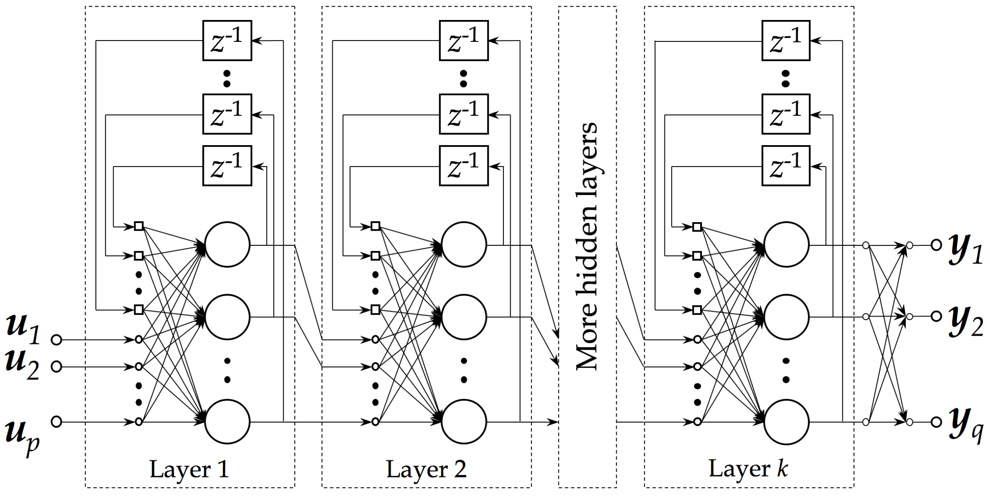
ELNN architecture
ELNN: Elman’s Neural Network [4] with local feedbacks
More works to extract the state variables (since they are everywhere with each layer)
Slightly lower variance in experiment

Slide 12
RNN for thermal model of building
Programmed in Python, with libraries PyBrain [5], NumPy [6], SciPy [7], Matplotlib [8]
2-norm regularization enabled in training to mitigate the over-fitting problem
We use RPropMinus [9], an adaptive back-propagation algorithm to train the RNNs
Input data is normalized before fed into the trainer to speed up training
Baseline data configuration:
Months 1-3, 5-7, 9-11 for training, 4, 8, 12 for validation

Slide 13
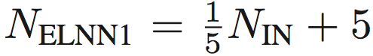


Network configurations
Empirical number of layers:
2 hidden layers for ELNN, 4 hidden layers for NLSS
Empirical size of layers:
ELNN
Hidden layer #1:
Hidden layer #2:
NLSS
Hidden layer #1-3:
Hidden layer #4:
Example: NLSS in 2-zone (all factors, #IN=11, #OUT=2): Uses layers with size (20, 20, 20, 2)

Slide 14
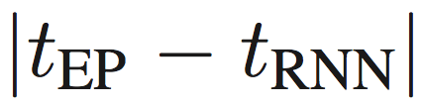
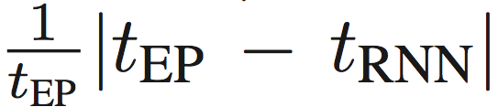
Error calculation
On each sampled output, we use two methods to calculate the modeling error
Absolute error: the actual difference between RNN output and EnergyPlus output:
Relative error: Absolute error divided by EnergyPlus output:
Average and maximum statistics are also calculated over the whole training data and validation data respectively

Slide 15
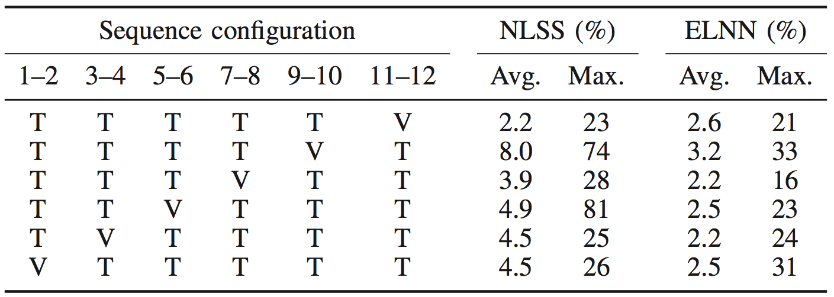
6-fold cross validation
We use every adjacent 2 months as a group
In each run of cross validation, we use one group to validate the model trained by the rest 5 groups
In 6-zone building RNNs
Validation error reduced from 34% to 23% in NLSS; from 23% to 16% in ELNN

Slide 16
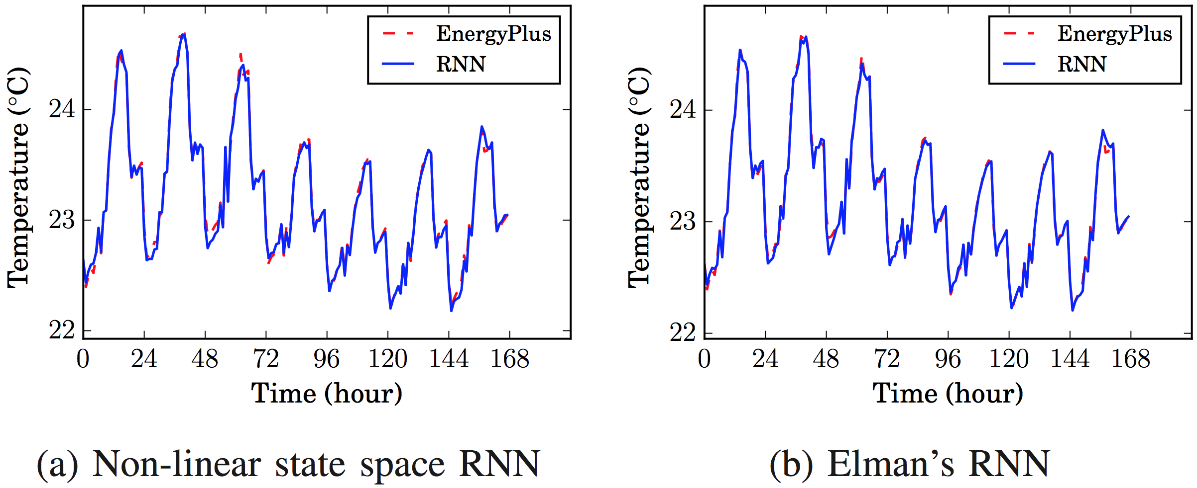
2-zone (all factors) modeling result
#IN=11, #OUT=2
Average error
ELNN 0.022°C/0.10%; NLSS 0.026°C/0.11%
Maximum error
ELNN 0.24°C/1.1%; NLSS 0.21°C/0.94%

Slide 17
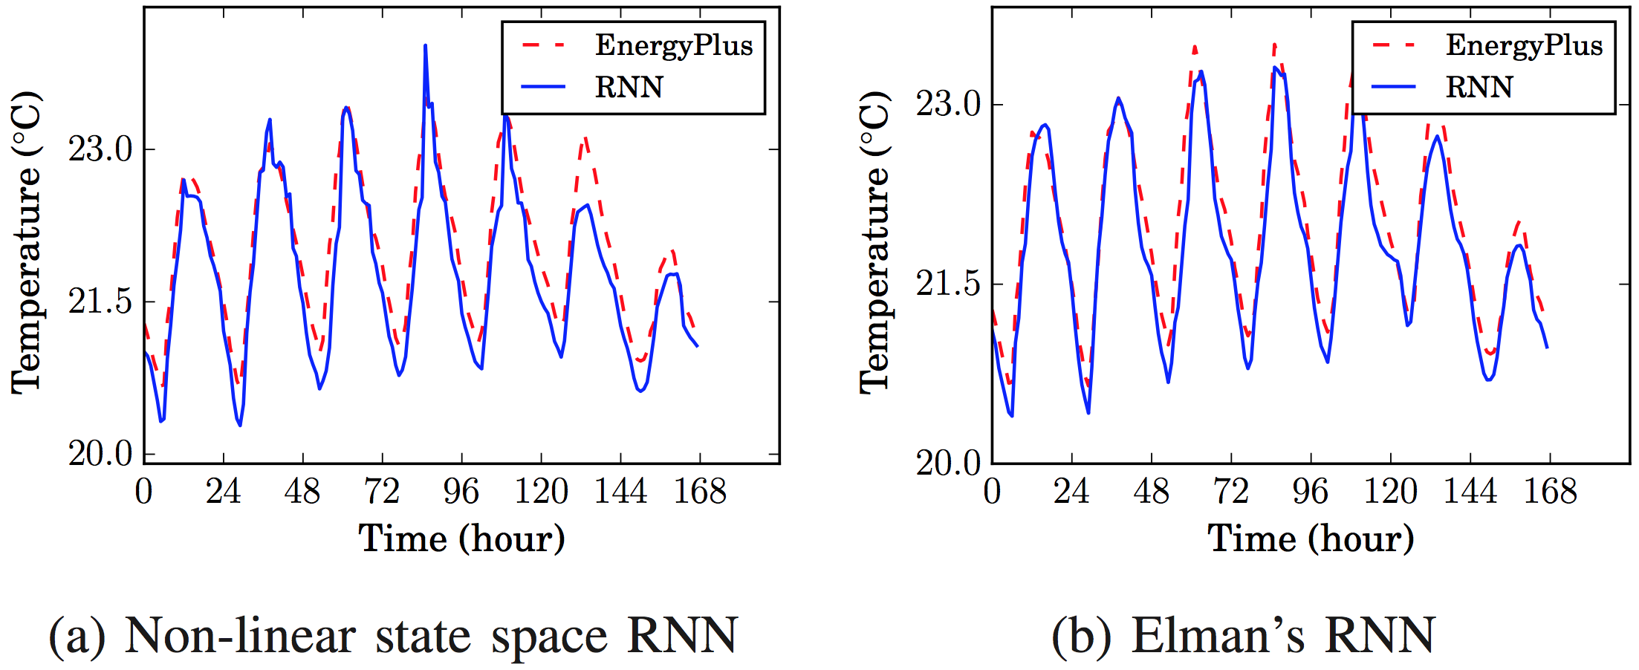
2-zone (HVAC) modeling result
#IN=3, #OUT=2
Average error
ELNN 0.20°C/0.98%; NLSS 0.23°C/1.2%
Maximum error
ELNN 1.34°C/6.5%; NLSS 1.4°C/7.0%

Slide 18
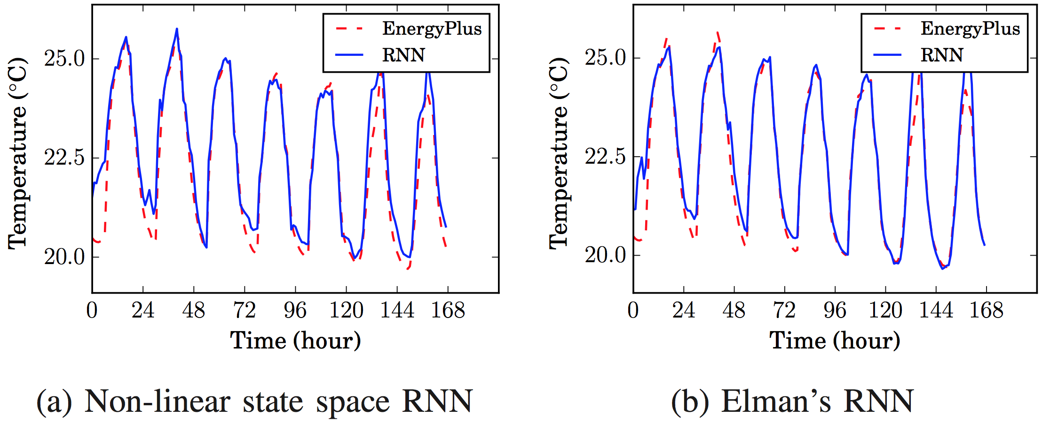
5-zone (all factors) modeling result
#IN=26, #OUT=5
Average error
ELNN 0.23°C/1.0%; NLSS 0.31°C/1.4%
Maximum error
ELNN 4.4°C/16%; NLSS 4.6°C/20%

Slide 19
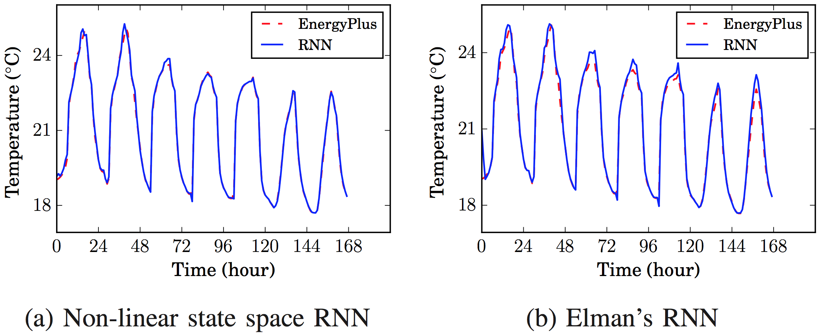
5-zone (HVAC) modeling result
#IN=6, #OUT=5
Average error
ELNN 0.16°C/0.71%; NLSS 0.057°C/0.26%
Maximum error
ELNN 2.2°C/12%; NLSS 2.2°C/9.6%

Slide 20
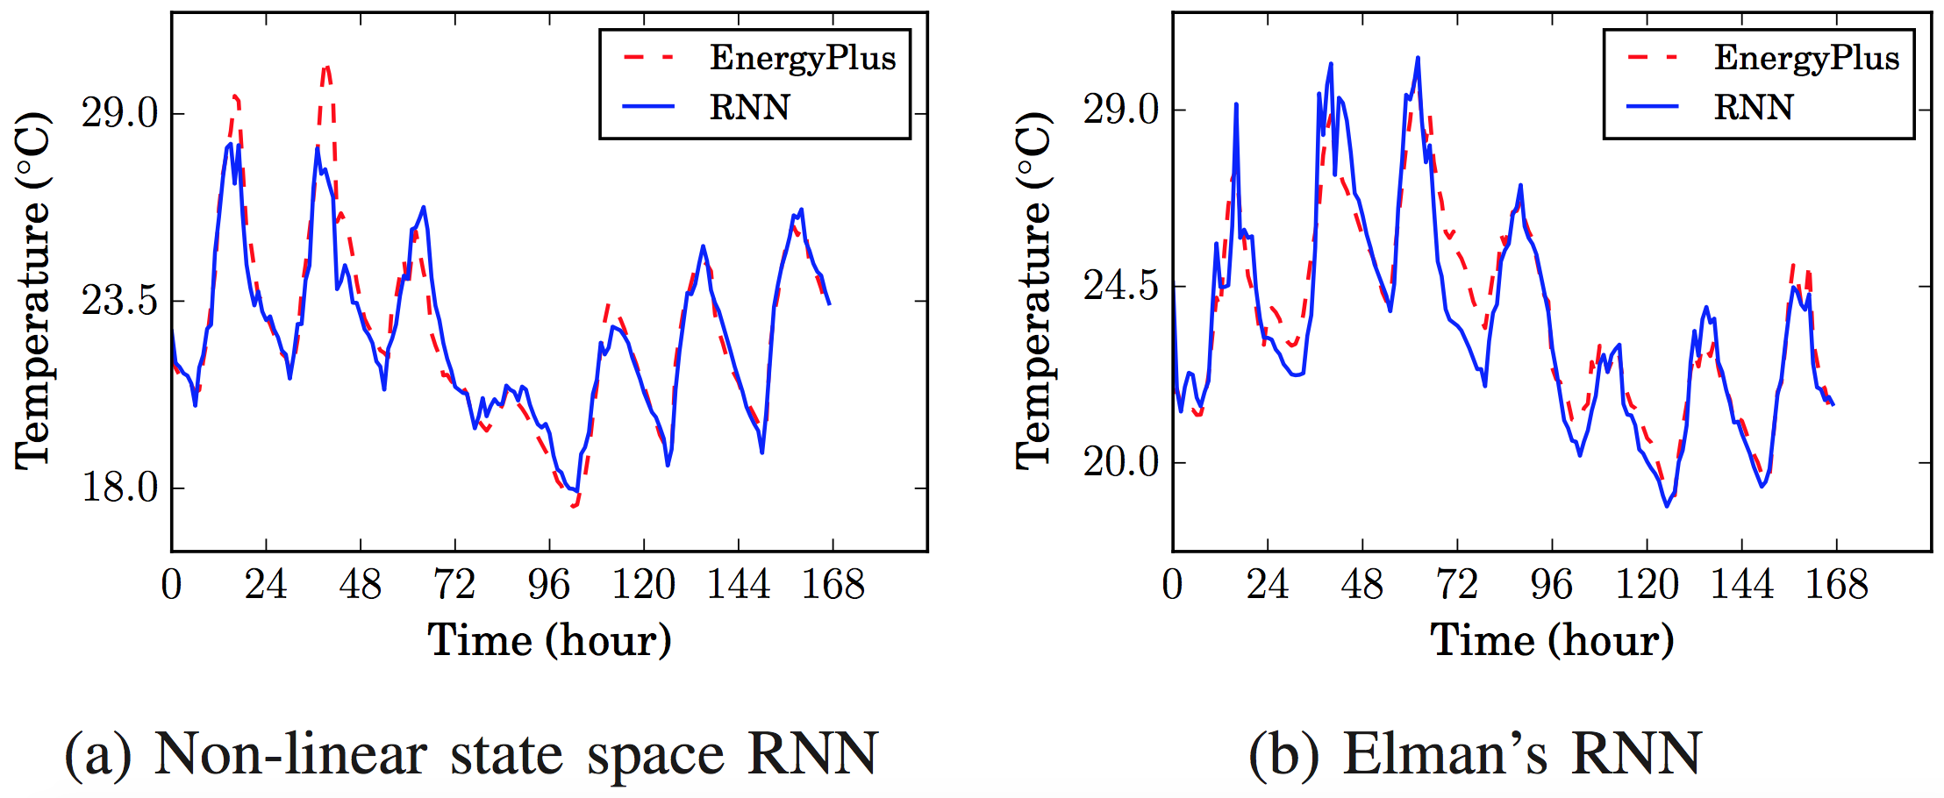
6-zone modeling result
#IN=55, #OUT=6
Average error
ELNN 0.53°C/2.2%; NLSS 0.48°C/2.2%
Maximum error
ELNN 4.1°C/16%; NLSS 4.8°C/23%

Slide 21
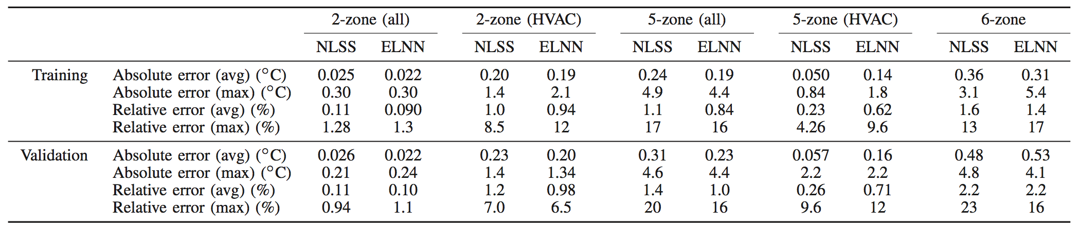
Summary
We did experiments on two RNN architectures on building thermal models
ELNN: Elman’s Neural Network with local feedbacks
NLSS: Non-Linear State Space Neural Network
We used cross-validation to reduce the modeling error on the 6-zone building case
Modeling errors
Simple 2-zone model: 1% ~ 1.5% relative error
Bigger 6-zone model: ELNN 16% and Elman 23%

Slide 22
Thank you!
Reference
[1] Building Energy Data Book of DOE. [Online]. http: //buildingsdatabook.eren.doe.gov
[2] M. Massoumy, Q. Zhu, C. Li, F. Meggers, and A. Sangiovanni-Vincentelli, “Co-design of Control Algorithm and Embedded Platform for Building HVAC Systems,” in International Conference on Cyber Physical Systems (ICCPS), Philadephia, PA, Apr. 2013, pp. 61–70.
[3] S. Haykin and N. Network, “A comprehensive fundation,” Neural Networks, vol. 2, no. 2004, 2004.
[4] J. L. Elman, “Finding structure in time,” Cognitive science, vol. 14, no. 2, pp. 179–211, 1990.
[5] T. Schaul, J. Bayer, D. Wierstra, Y. Sun, M. Felder, F. Sehnke, T. Ru ̈ckstieß, and J. Schmidhuber, “PyBrain,” Journal of Machine Learning Research, vol. 11, pp. 743–746, 2010.
[6] S. Van Der Walt, S. C. Colbert, and G. Varoquaux, “The numpy array: a structure for efficient numerical computation,” Computing in Science & Engineering, vol. 13, no. 2, pp. 22–30, 2011.
[7] E. Jones, T. Oliphant, P. Peterson et al., “SciPy: Open source scientific tools for Python,” 2001–, [Online; accessed 2015-07-23]. [Online]. Available: http://www.scipy.org/
[8] J. D. Hunter, “Matplotlib: A 2d graphics environment,” Computing in science and engineering, vol. 9, no. 3, pp. 90–95, 2007.
[9] C. Igel and M. Hu ̈sken, “Empirical evaluation of the improved rprop learning algorithms,” Neurocomputing, vol. 50, pp. 105–123, 2003.

